Slide 1
Attention Mechanism: Making the Network Smarter
Speaker: Kangqi Luo
Mar. 8th, 2017
Notes:
Hello everyone. This time we focus on using NN to handle different NLP tasks.
I’ll introduce “attention mechanism”, talk about its intuition and how the mechanism is applied in NN model.
Not expert in this field, just try my best share my knowledge with u & hope that you could learn something from my talk.
It’s a mechanism, rather than a model.

Slide 2
Content
Preliminary Knowledge
RNN, CNN …
Trip to Attention Mechanism
RNN: Machine Translation
CNN: Sentence Modeling
Conclusion
Notes:
First: I’ll give some brief introduction to the NN model, especially CNN, RNN, just make sure that all of u are clear with these concepts.
Then: We go through two real NLP tasks with the attention-based NN model, one is on RNN, and the other is on CNN.

Slide 3
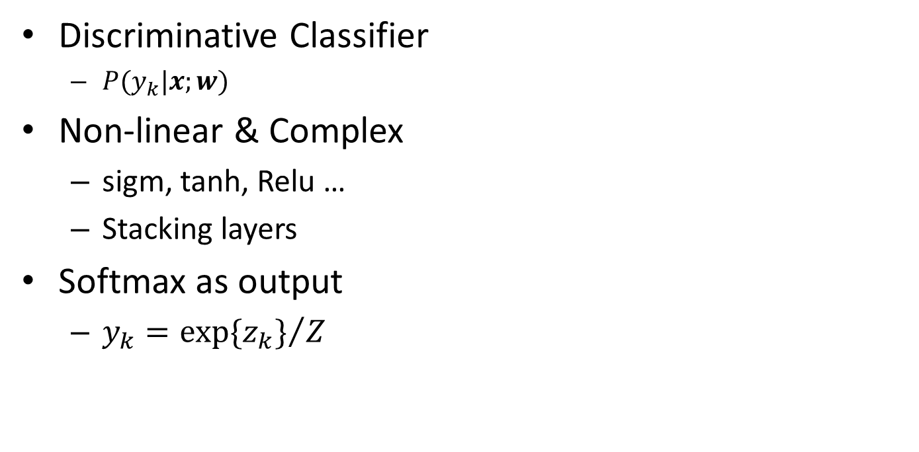




Intuition of NN
$$h_{m}=f_{θ}^{\left(m\right)}\left(x\right)$$
Discriminative Classifier
$P(y_{k}|x;w)$
Non-linear & Complex
sigm, tanh, Relu …
Stacking layers
Softmax as output
$y_{k}={exp⁡\{z_{k}\}}/Z$
x₀=1
h₀=1
$$z_{k}=f_{φ}^{\left(k\right)}\left(h\right)$$
z₁
y₁
x₁
$$θ^{\left(1\right)}$$
h₁
$$φ^{\left(1\right)}$$
z₂
y₂
x₂
h₂
z_{K}
y_{K}
x_{N}
h_{M}
| non-linear | non-linear | normalization |
input layer (N)
hidden layer (M)
output layer (K)
Notes:
NN: discriminative classifier: p(y|x;w),
Discriminative classifier, that is: model prob. of yk given input x and a huge number of parameters.
for example, hand-writing digit recog problem, x: brightness of each pixel, y: 0~9
We may get different inputs in different tasks, but the common goal is to learn such classifier.
Once all parameters are trained, we could use it just like using a black box.
Activation function enables the NN to represent an non-linear probability function
Since there are so many parameters we can use NN to represent very complex model.
Softmax: serves as the output layer, which uses exponential normalization function to turn the hidden vector into a probability distribution.

Slide 4
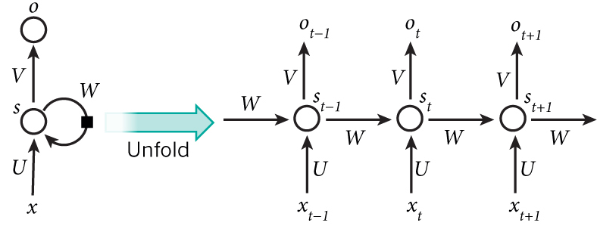
Preliminary: Recurrent Neural Network
Handling tasks with sequential data
$$s_{t}=tanh⁡(Ux_{t}+Ws_{t−1})≜f(x_{t},s_{t−1})$$
Notes:
RNN is one popular structure, which is able to handle tasks with sequential data.
Left: conventional RNN unit; Right: unfolded structure.
hidden vector of the current timestamp is determined by the last state and the current input.
As we can see from the formula, st is the output of a fully connected layer, with xt and st-1 as input.
Simply the process into a f function,
f: in general (conventional RNN unit, LSTM, GRU)
Almost all symbols are vectors or matrices during the whole presentation.
Capital letter: matrix; other: vector

Slide 5
Preliminary: Convolutional Neural Network
Features from locally connected areas
sub region of a picture, n-gram in a sentence
M
0.85
0.10
0.02
0.10
0.03
S
Q
0.85
0.78
0.04
M
(P-S+1)(Q-S+1)
P
Notes:
when modeling the hidden feature vector of the whole input, for example, a picture, or a long sentence,
CNN first generate features from locally connected areas in a convolutional way,
and then merge all sub-region features into the final feature vector, this step is called pooling.
We often use max pooling strategy, just shown in the figure, but sometimes there may have alternatives.

Slide 6
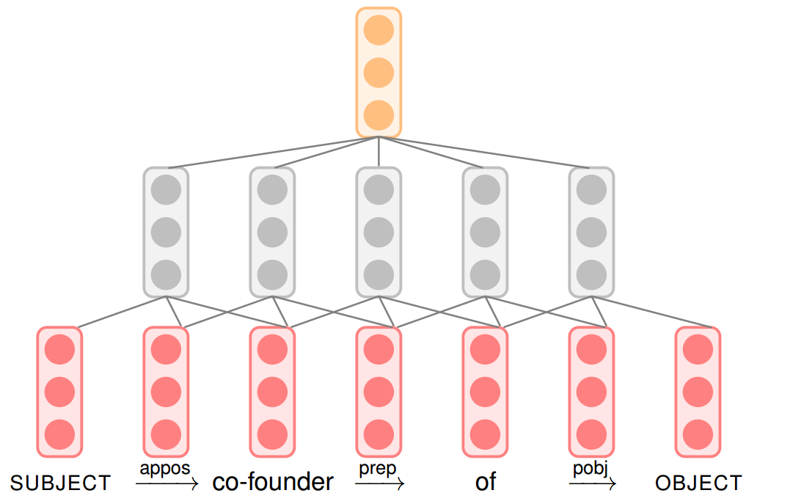




Preliminary: CNN
Output: Embedding of whole pattern
Max Pooling
$$r_{j}^{}=max⁡\{h_{j}^{\left(i\right)}\}$$
$$h_{j}^{\left(i\right)}=f_{θ_{j}}\left(g^{(i)}\right)$$
Conv. Layer
$$g^{(i)}=[v^{\left(i−1\right)};v^{\left(i\right)};v^{\left(i+1\right)}]$$
$$v^{(i)}=Vw^{(i)}$$
Notes:
ANY QUESTIONS UP TO NOW?

Slide 7
READY? LET’s drive!
Notes:
hope that u guys have some basic intuition of these structure.
And now, let’s drive!
Starts from RNN model for MT task.

Slide 8
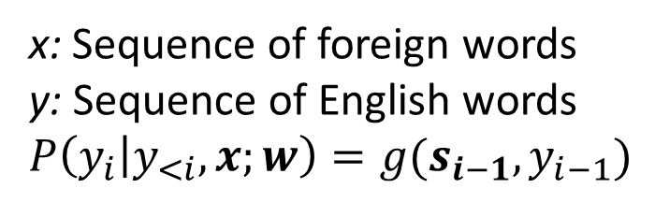
Real Example of RNN: Machine Translation
x: Sequence of foreign words
y: Sequence of English words
$$P\left(y_{i} | y_{<i},x;w\right)=g(s_{i−1},y_{i−1})$$
Knowledge
is
power
#END#
y_{i}
h_{i}
V
W_{enc}
W_{dec}
s_{i}
U
y_{i-1}
知识
就
是
力量
#END#
#START#
Knowledge
is
power
x_{i}
Encoder
Decoder
Notes:
Sequence to sequence model
input: sequence of foreign words with varied length.
output: sequence of English words (also with varied length)
Don’t forget the goal: model P(yi|history, x)
When predicting yi, the NN takes all x and y_prev as input, and returning the prob dist over all the candidate words.
Adv of RNN: works well even we don’t know the length of output sentence
(The procedure stops at #END#)
If we only focus on the part that outputs yi, we simplify the formula into g function,
where g is a nonlinear, potentially multi-layered function.
If asking: (draw on white board)
x: 1-hot vector → w2v vector
y (input): the same as x
y (output): probability distribution over all candidates.

Slide 9

Minor Changes of the Model
知识
就
是
力量
#END#
The decoder receives the encoded sentence vector when predicting every word (not just the first).
W_{enc}
h_{i}
c
$$g(s_{i−1},y_{i−1}, c)$$
s_{i}
W_{dec}
Quiz: Is there any more improvements on c ?
#START#
Knowledge
is
power
#END#
Notes:
When predicting the next word, the decoder could still
receive encoded hidden vector of the whole input sentence, that is c in the figure.
Compared with traditional model, the representation is used only once at the beginning of decoder.
This time, the g function receives c as input

Slide 10

Minor Changes of the Model
知识
就
是
力量
#END#
Taking an aggregation over the hidden vector at each timestamp to represent the encoded sentence vector.
W_{enc}
h_{i}
c_{i}
$$g(s_{i−1},y_{i−1}, c_{i})$$
s_{i}
W_{dec}
#START#
Knowledge
is
power
#END#
Notes:
What about modeling c as the aggregation over all the hidden vectors at each timestamp?
Turning c to ci: this is important: Intuition is that, we choose suitable representations for predicting the current word.
For example, I’m going to translate this sentence, I many focus on “是” when predicting the second word “is”,
and “力量” when predicting the third word “power”
If the model could find such focus, we’ll hopefully improve the translating result.
Intuition: “is” and “power” focus on “是”and “力量”. This focus mechanism is what we called attention!
Here comes the question: how to get c_i?

Slide 11
Attention: A Biased Aggregation
Intuition: When predicting the next English word, let the sentence vector be biased towards the highly related foreign words.
How to aggregate hidden vectors at diff. position ?
Average Pooling? (No bias over encoded vectors)
Max Pooling? (The bias is fixed)
Dynamic Weighted Sum!
Notes:
Let me explain the intuition again.
How to aggregate? max ? average ?
avg: no bias
max: bias is fixed

Slide 12

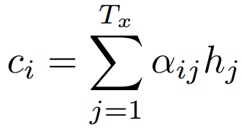
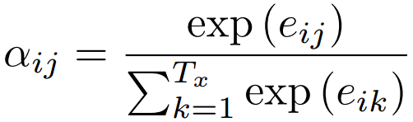


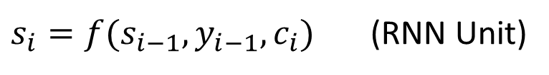


Attention Mechanism: Detail
x₁
x₂
x₃
h_{j}
$$α_{i2}$$
$$α_{i1}$$
$$α_{i3}$$
c_{i}
$s_{i}=f(s_{i−1}, y_{i−1},c_{i})$ (RNN Unit)
s_{i}
$$P\left(y_{i} | y_{<i},x\right)=Softmax(Vs_{i})$$
V
y_{i-1}
y_{i}
Notes:
Attention is a mechanism, rather than a new model.
The key function e_ij in the attention mechanism is an alignment model which scores how well the inputs around position j and the output at position i match.
(Essence: a fully conn. layer) We need to draw on whiteboard.
Input: decoded vector si-1 and encoded vector hj.
The score is based on the RNN hidden state si−1 (just before emitting yi, Eq. (4)) and the j-th annotation hj of the input sentence.
alpha: softmax output of e, which is the attention weight.
ci: weighted sum of all the encoded vectors
The last step of generating y_i: Not the same as the paper.

Slide 13
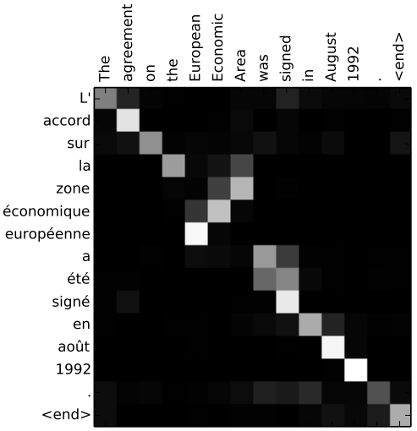
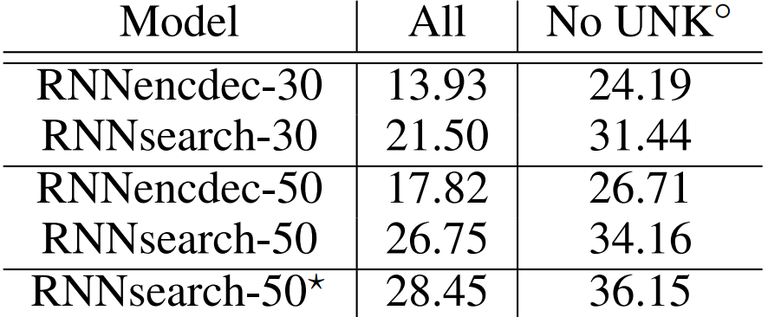
Visualization
BLEU scores of different model on MT task
Neural Machine Translation by
Jointly Learning to Align and Translate
Bahdanau et al., ICLR 2015
Notes:
The agreement on the European Economic Area was singed in August 1992 .
Visualize attention matrix alpha_ij.
Recap that attention: serve as the alignment model.
The matrix automatically captures the signal, without explicit alignment training data.
RNNsearch-30 > RNNencdec-50

Slide 14







More Variances
x₁
x₂
x₃
Effective Approaches to Attention-based Neural Machine Translation
Luong et al., EMNLP 2015
h_{j}
$$α_{i2}$$
First variance: Overall structure
$$α_{i1}$$
$$α_{i3}$$
$${\tilde{s}}_{i}$$
c_{i}
$$s_{i}=f(s_{i−1},y_{i−1})$$
s_{i}
$${\tilde{s}}_{i}=tanh⁡(W_{c}[c_{i};s_{i}])$$
$$P\left(y_{i} | y_{<i},x\right)=Softmax(V{\tilde{s}}_{i})$$
y_{i-1}
y_{i}
Notes:
Little difference: The structure.
First difference: structure of the network. (An alternative attention-based NN structure)
Previous: st-1 → a → c → st
Now: st → a → c → ~st
general: Bilinear form: f(u, w) = uT A w
concat: perceptron

Slide 15
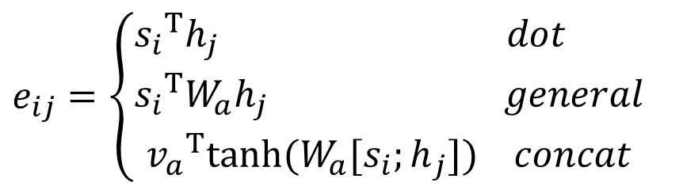
More Variances
x₁
x₂
x₃
Effective Approaches to Attention-based Neural Machine Translation
Luong et al., EMNLP 2015
h_{j}
$$α_{i2}$$
Second variance: score function
$$α_{i1}$$
$$α_{i3}$$
$${\tilde{s}}_{i}$$
c_{i}
$$e_{ij}=\left\{\begin{aligned}{s_{i}}^{T}h_{j} dot \\ {s_{i}}^{T}W_{a}h_{j} general \\ {v_{a}}^{T}{tanh⁡(W}_{a}{[s_{i};h}_{j}]) concat\end{aligned}\right.$$
s_{i}
y_{i-1}
y_{i}
Notes:
Little difference: The structure.
First difference: structure of the network. (An alternative attention-based NN structure)
general: Bilinear form: f(u, w) = uT A w
concat: perceptron
dot and general works better than concat. Currently it’s hard to say why.

Slide 16
Real Example of CNN: Sentence Modeling
ABCNN: Attention-Based Convolutional Neural Network for Modeling Sentence Pairs
Yin et al., TACL 2016
Modeling a pair of sentences in NLP tasks
Answer Selection
Paraphrase Identification
Textual Entailment
Notes:
In this paper, the author mentioned 3 NLP tasks, called AS, PI TE.
These task has a common format: Give you a source sentence and two candidate target sentences, judge which target sentence has some particular relation,
with respect to the source sentence.
So the goal is to model a pair of sentences.

Slide 17
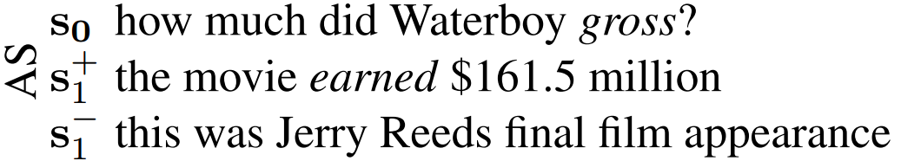
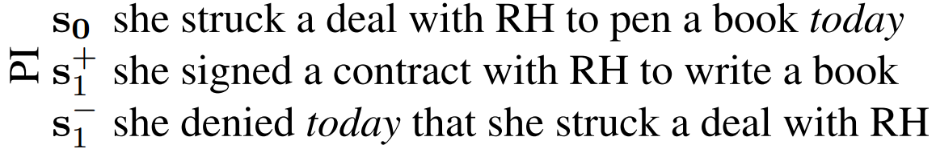
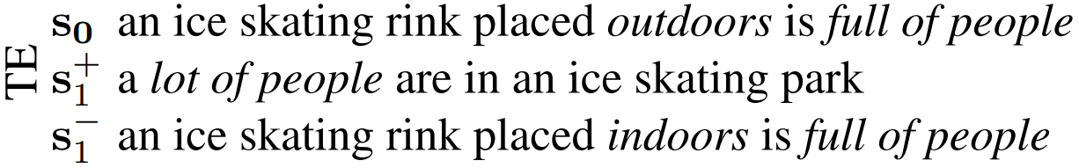
Real Example of CNN: Sentence Modeling
Attention is important in the task!
Notes:
Let me show you examples that why we need to use attention mechanism in these tasks.
For AS, correctly answering s0 requires putting attention on “gross”: s+ 1 contains a corresponding unit (“earned”) while s− 1 does not.
For PI, focus should be removed from “today” to correctly recognize (< s0, s+ 1 >) as paraphrases and (< s0, s− 1 >) as non-paraphrases.
For TE, we need to focus on “full of people” (to recognize TE for < s0, s+ 1 >) and on “outdoors” / “indoors” (to recognize non-TE for < s0, s− 1 >).
These examples show the need for an architecture that computes the attention of words across diff. sentences.

Slide 18
Basic Model: BCNN
n-dim
output
Bi-CNN structure
Siamese architecture
P(y=true | x₀, x₁)
d-dim
d-dim
Conv-Pool
Conv-Pool
d * s₀
d * s₁
Conv-wPool
Conv-wPool
……
……
E * s₀
E * s₁
Notes:
First I’ll show you the basic model in this paper, called BCNN.
This bi-CNN model is based on the architecture called “Siamese Network”, which consists of two CNNs (weight sharing in this case, since both LF and RT are sentences),
each processing one of the two sentences into the hidden vector.
The traditional Siamese network only has one CNN block in each branch, but this paper has one more:
there’s a special layer “conv-wPool”, and I’ll show it in the next slide.
Input: embedding vector of s0 words (embedding dim = E)
After conv-wPool: d * s0, d is the number of feature maps in the layer.
After conv-Pool: d-dim vector. (number of features in diff. )
Why not LSTM?
U may ask, why not using RNN model here?
Explanation is: CNNs benefit from incorporating attention into representations of local phrases detected by filters (sliding window)
in contrast, LSTMs encode the whole context to form attention-based word representations – a strategy that is more complex than the CNN strategy
and (as our experiments suggest) (in this experiment) performs less well for some tasks

Slide 19
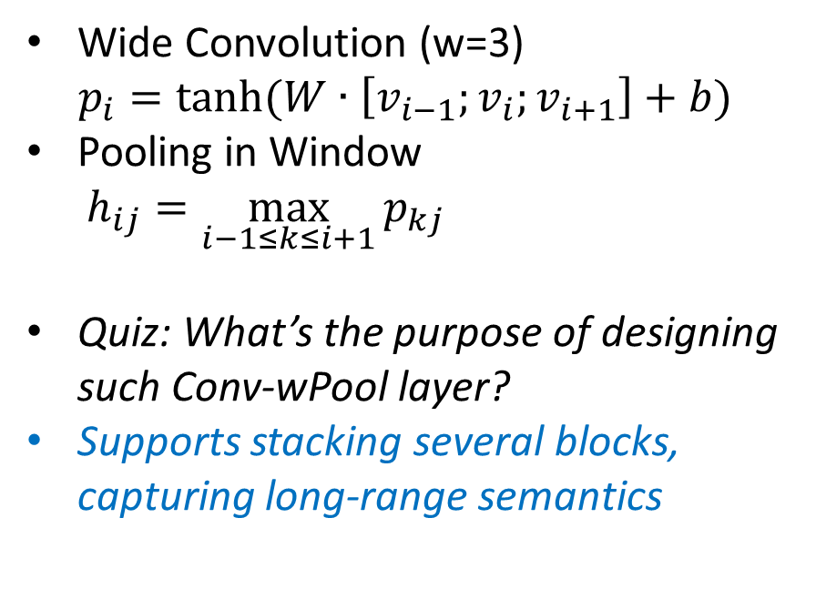
Conv-wPool
s₀ = 5
h_{i}
Wide Convolution (w=3)
$$p_{i}=tanh⁡(W∙\left[v_{i−1};v_{i};v_{i+1}\right]+b)$$
Pooling in Window
$$h_{ij}=\max_{i−1≤k≤i+1}{p_{kj}}$$
Quiz: What’s the purpose of designing such Conv-wPool layer?
Supports stacking several blocks, capturing long-range semantics
Window Pooling
p_{i}
s₀+w-1 = 7
Wide Conv.
v_{i}
s₀ = 5
Notes:
Wide convolution: set window to be 3
notice the first 3 vectors p1, p2, p3, p1 links from v1 only,
capture phrases in the corner of the sentence.
v: w2v vector
p: phrase conv vector
Pooling: the window is applied in this step, returning s0 hidden vectors.
Allow multi stack. Set as a quiz.

Slide 20
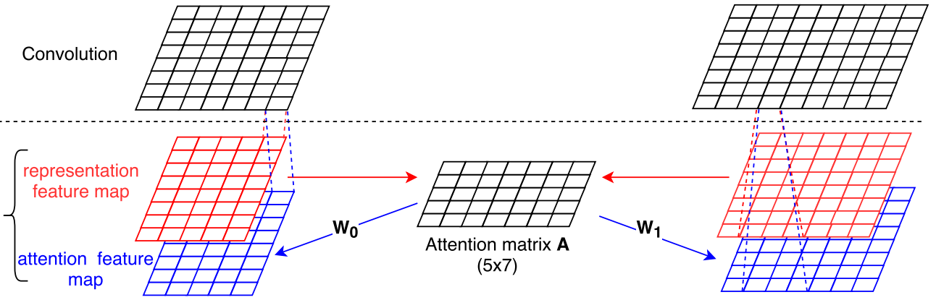







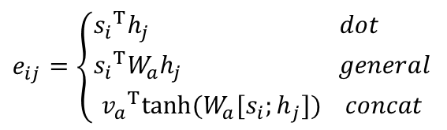
ABCNN-1
$$e_{ij}=\left\{\begin{aligned}{s_{i}}^{T}h_{j} dot \\ {s_{i}}^{T}W_{a}h_{j} general \\ {v_{a}}^{T}{tanh⁡(W}_{a}{[s_{i};h}_{j}]) concat\end{aligned}\right.$$
W₀: d * s₁
W₁: d * s₀
Notes:
Let’s see how the attention works in CNN model.
Suppose there are 5 word in the sentence s0, and 7 words in the sentence s1.
Representation feature map: the word embedding features for each word, or maybe hidden features for each phrase.
Attention features are intended to weight those words of s0 more highly in convolution that are relevant to a unit of s1
Again: each cell in the attention matrix is a score between two embedding vectors.
Remember that we may have several choices to calculate the score.
And the author designed a new one, based on the L1-distance of the two vectors.
A can be viewed as a new feature map of s0 in row direction, and also a new feature map of s1 in column direction.
Thus we could combine this new feature map with the original representation feature map, and put them together into conv layer.
The author used two parameter matrices W0 and W1, transforming A into two blue matrices called “attention feature map”
As the result, the input of conv. layer has two feature maps for each sentence.
The motivation is that the attention feature map will guide the convolution to learn “counterpart-biased” sentence representations

Slide 21


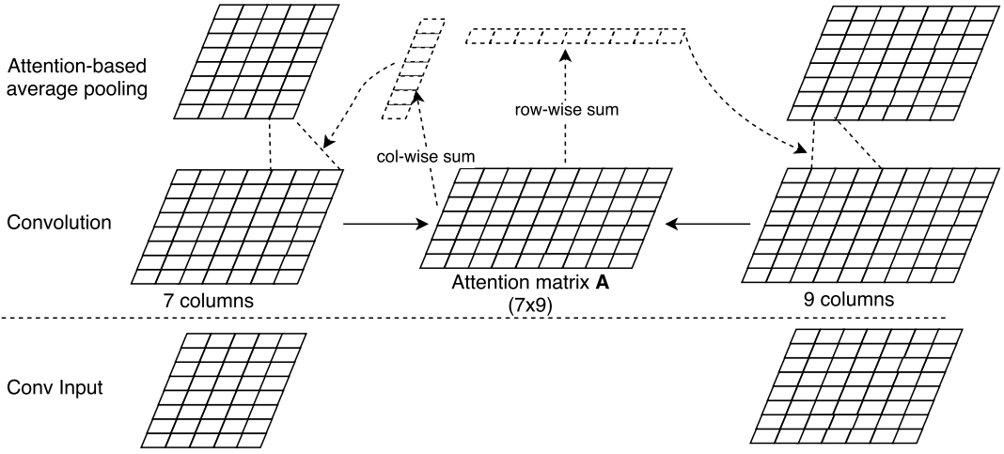
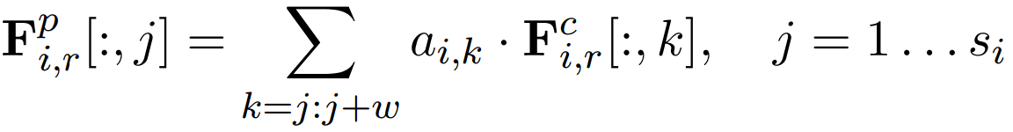




ABCNN-2
$${F_{0,r}}^{p}$$
$${F_{1,r}}^{p}$$
$${F_{0,r}}^{c}$$
$${F_{1,r}}^{c}$$
Notes:
put the attention mechanism at pooling level.
a0j: attention weight of j-th unit in s0, and also we have a1j in s1.
then the window pooling step is replaced by a weighted sum operation, which is similar with the attention in the previsous RNN example.

Slide 22
Comparison between ABCNN-1 & 2
Impact to convolution layer
ABCNN-1: Impacts indirectly (providing extra feature map)
ABCNN-2: Impacts directly (attention-based pooling)
Extra parameters
ABCNN-1: W₀ and W₁, and larger convolution matrix
ABCNN-2: Nothing!
Granularity
ABCNN-1: word (low) level; ABCNN-2: phrase (high) level
Notes:
There are three main differences between ABCNN-1 and ABCNN-2. (i) Attention in ABCNN-1 impacts convolution indirectly while attention in ABCNN-2 influences pooling through direct attention weighting. (ii) ABCNN-1 requires the two matrices Wi to convert the attention matrix into attention feature maps; and the input to convolution has two times as many feature maps. Thus, ABCNN-1 has more parameters than ABCNN-2 and is more vulnerable to overfitting. (iii) As pooling is performed after convolution, pooling handles larger-granularity units than convolution; e.g., if the input to convolution has word level granularity, then the input to pooling has phrase level granularity, the phrase size being equal to filter size w. Thus, ABCNN-1 and ABCNN-2 implement attention mechanisms for linguistic units of different granularity.

Slide 23
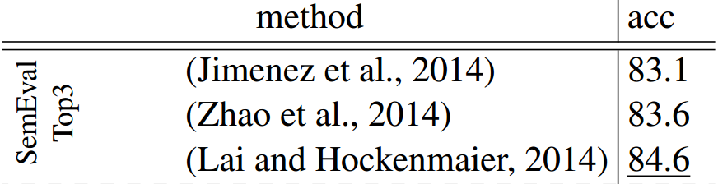
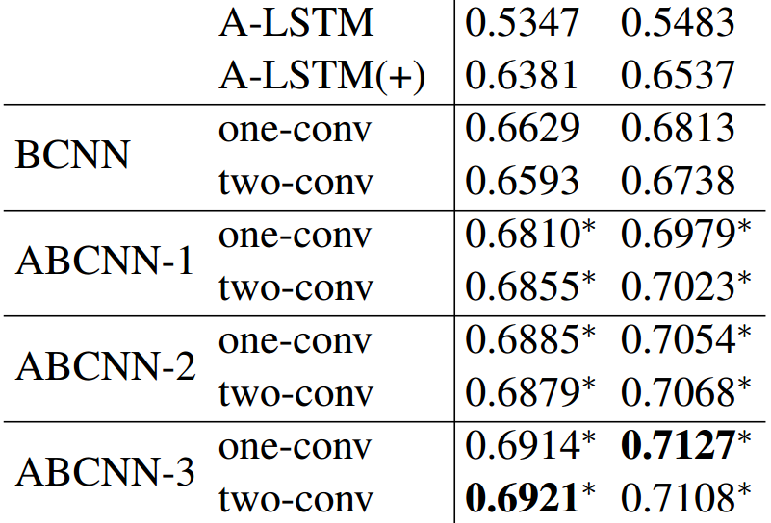
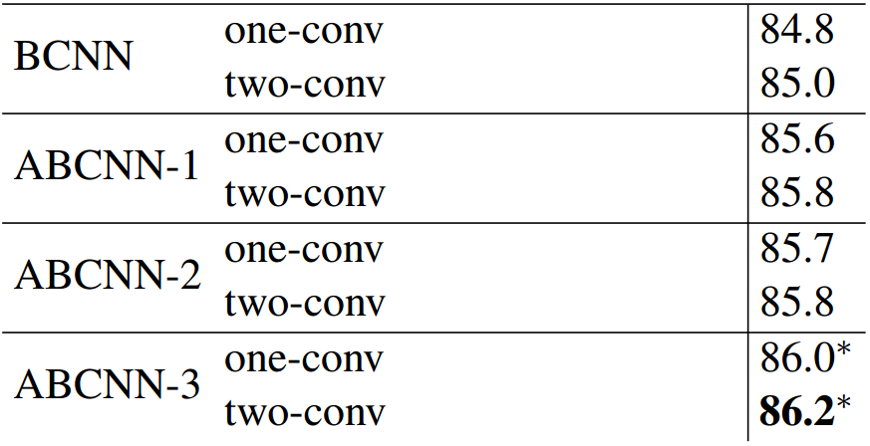
ABCNN-Evaluation
Answer Selection: Results on WikiQA.
Textual Entailment: Results on SICK.
Notes:
ABCNN-3: combined model of two attention mechanisms.
WikiQA answer selection & SICK textual entailment
has promising results compared with baselines and state-of-the-arts.

Slide 24
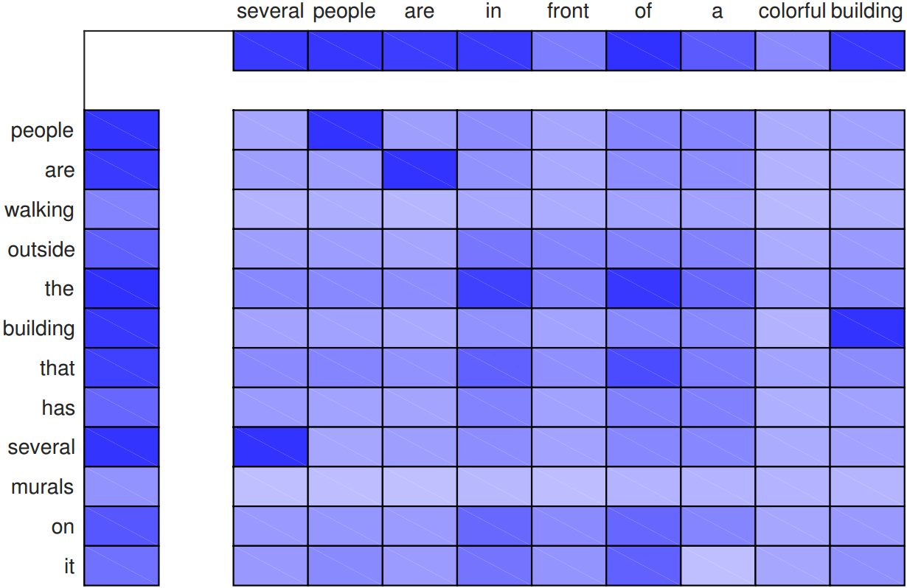
Attention Visualization (ABCNN-2)
Notes:
s₀: people are walking outside the building that has several murals on it.
s1: several people are in front of a colorful building.
Visualization of attention matrix in ABCNN-2
two similar words get higher attention, which makes sense

Slide 25
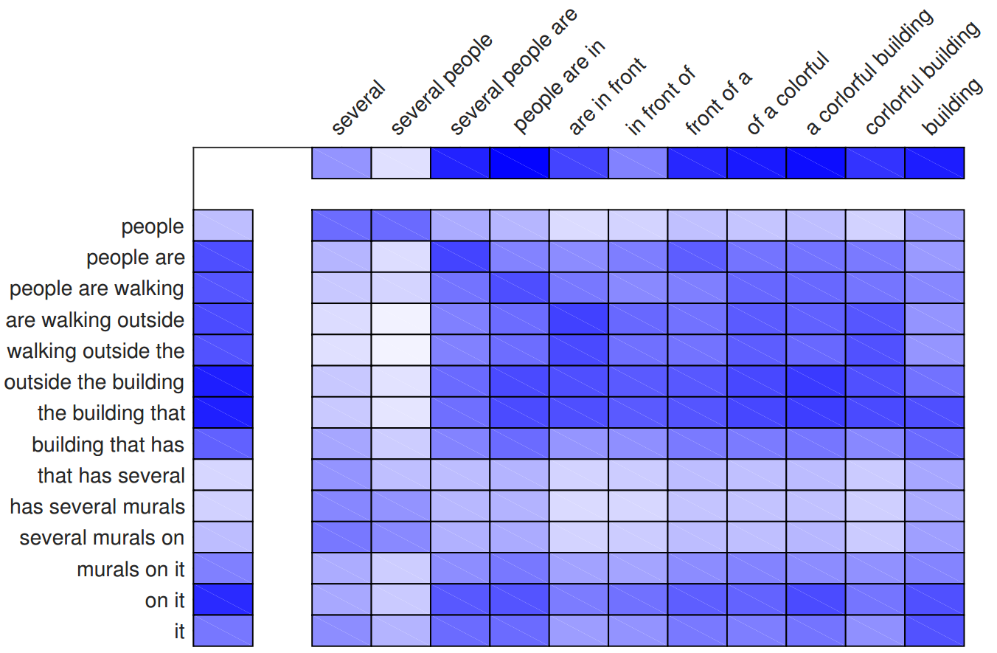
Notes:
Analyze the attention matrix trigram level: the matrix value gets smoother.
Capture phrase level semantic correspondence: “people are” v.s. “several people are”
“are walking outside” and “walking outside the” in s0 match “are in front” in s1;
“the building that” in s0 matches “a colorful building” in s1. Focus on the right-down corner: both “on it” and “it” in s0 match “building” in s1; this indicates that ABCNN is able to detect some co-reference across sentences

Slide 26
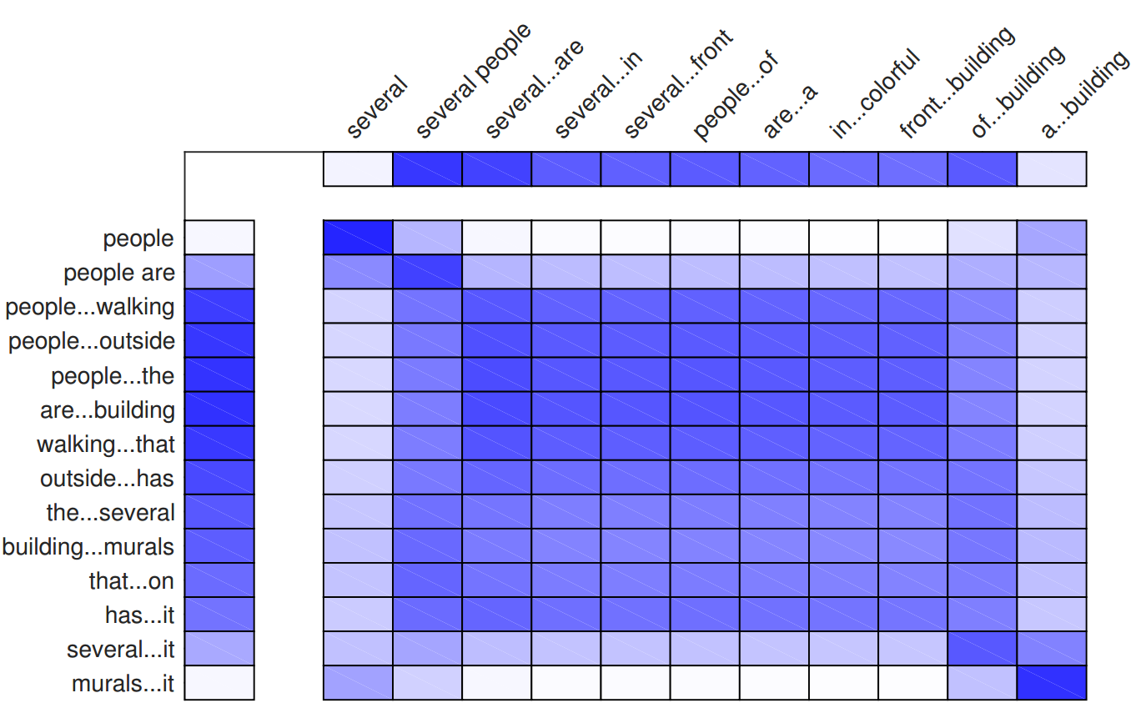
Notes:
Higher level: phrases with length 5
More and more smooth
“people are walking outside the building that ” v.s. “several people are in front of a colorful building”
Right corner: higher attention between “several murals on it” vs “a colorful building”
successfully captures the crucial information for the textual entailment.

Slide 27
Take-Home Messages
Attention: dynamic weighting strategy, mining the relatedness between different components in the model.
Advantage: Visualize the attention matrix to see what’s going on during the learning step.
Attention mechanism brings additional parameters, so make sure that we have enough training data.

Slide 28
THANKS FOR listening!
Question & Answers

